Slide 1

Welcome to our Presentation

Slide 2

Object Oriented Programming-1
Section:- J
Grourp-3
Presenting to-
MD. NAZMUL HOSSAIN
LECTURER, CS
AMERICAN INTERNATIONAL UNIVERSITY BANGLADESH

Slide 3



Group Members
MD.SHARIAR MAHMUD SACHCHA
20-43772-2
TASNIA BINTE WAHID 20-43929-2
S.M. ABU HURYRA 20-42480-1

Slide 4


Project Title:

Slide 5

Project Objective\Motivation
We inspired from AIUB result processing system. It is quit interesting and we feel it is a good idea for our project.
The system displays the list of all issues that are open, close in progress. If the user log into the system as student, they can show their result . And other side Teacher can update or modify result in this system.

Slide 6
User
Functionality
Contribution
Drawback
Exit
Project Details
(Home)

Slide 7
Teacher
Student
Admin
USERS:
Home

Slide 8
Admin can log in to the system with their unique user id and password. Admin can view and update various things such as personal details of students, teachers and their own.
ADMIN
Users

Slide 9
Teachers are required to log in to the system with their unique log in id consisting of username and password. They can further view results of a student and update it.
TEACHER
Users

Slide 10
Students have their unique username and password to log in to the system. They can view their result which set by teacher. Student can show result but do not change anything.
STUDENT
Users

Slide 11

Functionalities:
Home
Next Step

Slide 12


Log-in

Slide 13
choose Log in
Admin
Teacher
Student
User Id:
User Id:
User Id:
Password:
Password:
Password:
SIGN IN
SIGN IN
SIGN IN

Slide 14
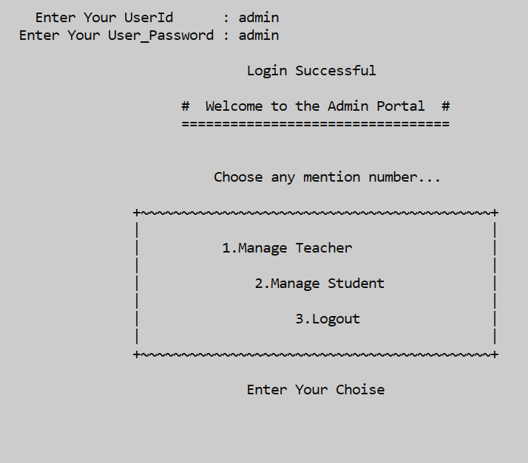
AFTER LOGIN (ADMIN)

Slide 15
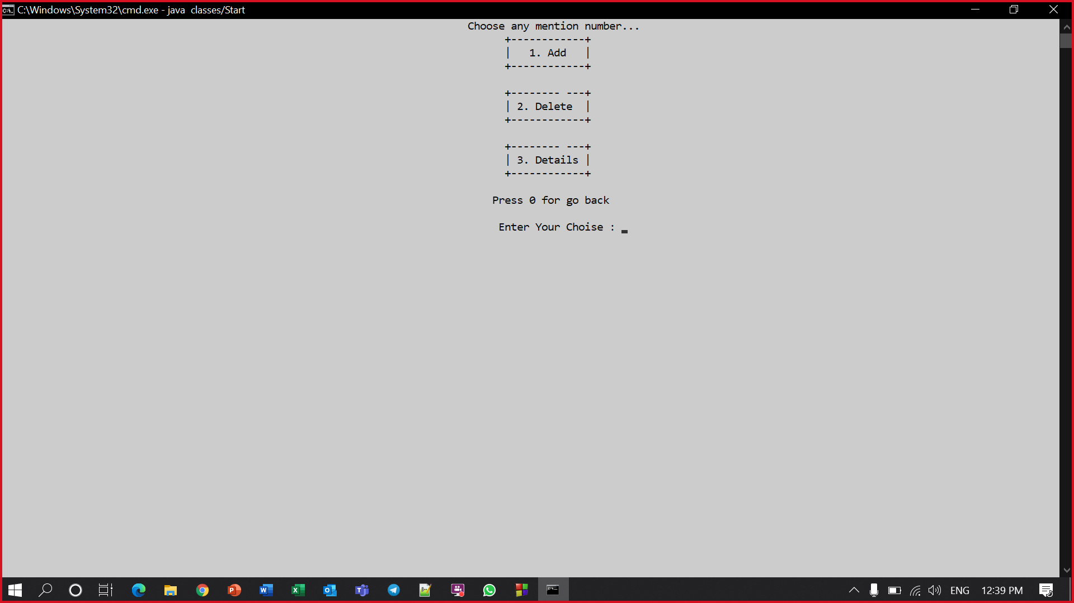
Manage Teacher
(ADMIN)

Slide 16
Manage Student
(ADMIN)

Slide 17
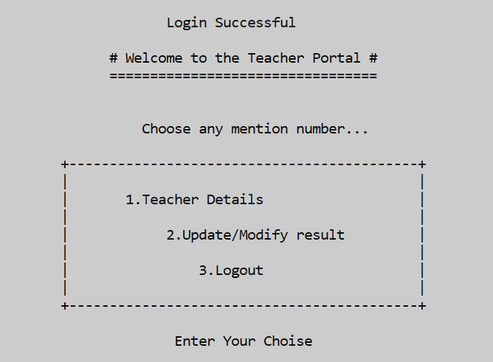
AFTER LOGIN (TEACHER)

Slide 18
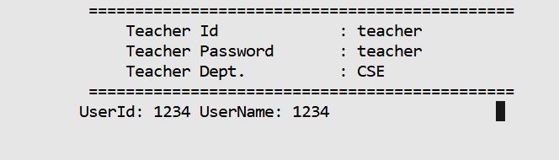
Teacher Details
(TEACHER)
Press 0 for go back

Slide 19
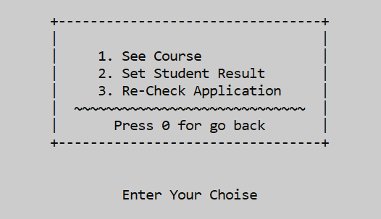
Update/Modify result
(TEACHER)

Slide 20
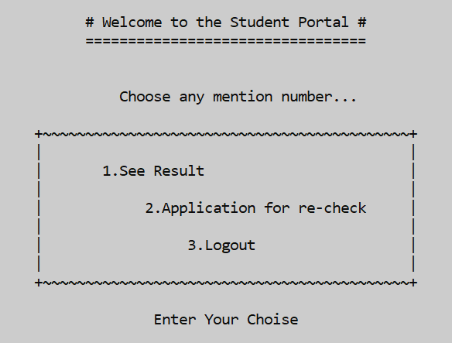
AFTER LOGIN (STUDENT)

Slide 21
See Result
(STUDENT)
Enter Student User Id:
Enter Quiz1 marks :
Enter Quiz2 marks :
Enter viva marks :
Enter Assignment Marks :
Enter performance &attendance marks :
Total marks :
Press here to go back

Slide 22
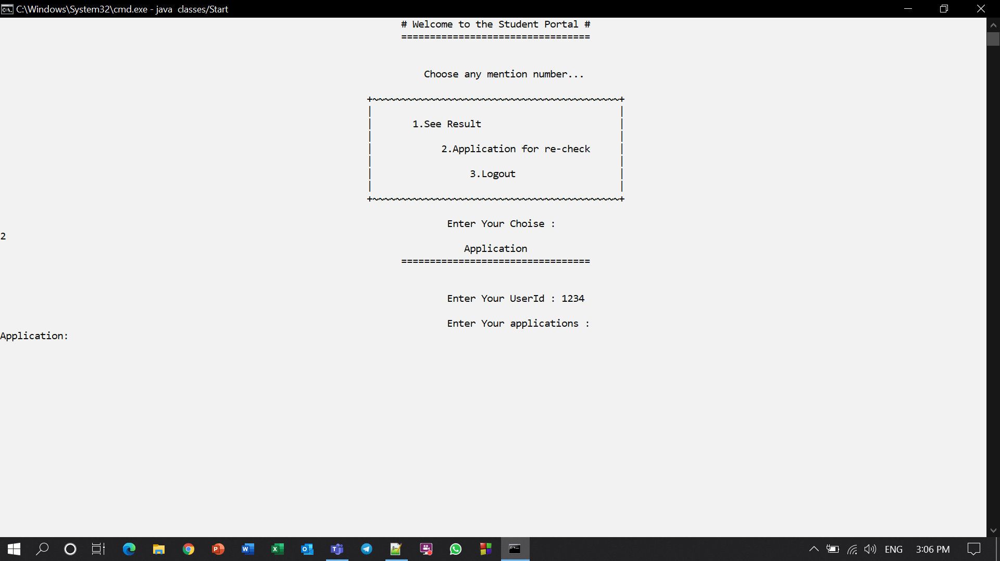
Application for re-check (STUDENT)
2
\|
Press 0 to go back

Slide 23

Drawback
The system we created only shows the sum of the number obtained by the student. In future we will create a method which will calculate the grade point also cgpa of the student by semester.
Add a method which will give permission to student to download their result sheet.
Graphical user interface can be added.
Home

Slide 24

Contribution:
MD. SHARIAR MAHMUD SACHCHA
Menu, Login , Result Upload / Modify Result.
TASNIA BINTE WAHID
Select Course, Select Section
S.M. ABU HURYRA
Show Student Result, Registration for re-check
Home

Slide 25


